Slide 1
Chapter 03 – Cont.
Transformers

Slide 2
Introduction
Transferring electrical energy
  From one circuit to another
    Through time-varying magnetic field
Applications
  Both power and communication fields
  In transmission, distribution of electrical energy.
    Step-up, step down voltages
    50/60Hz, hundreds of watts to hundreds of megawatts
Trịnh Hoàng Hơn
ICA Lab

Slide 3
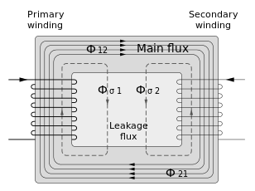
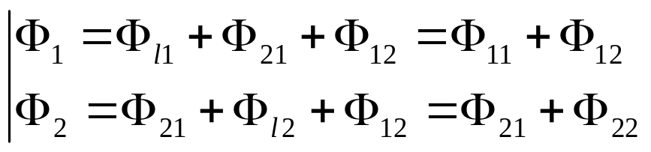
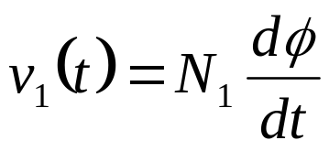
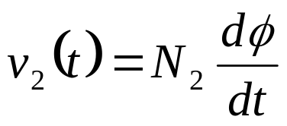
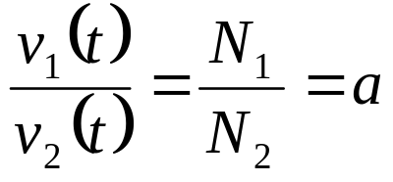
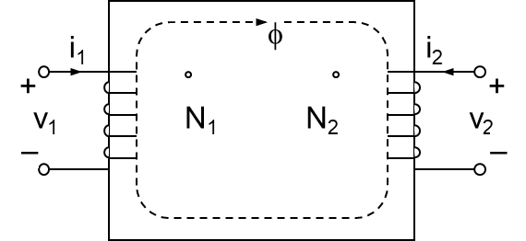
Ideal transformer (1)
Consider a magnetic core
  Two coils
  Assume
    No losses, stray capacity,
    leakage flux
    Magnetic permeability, μ→∞
⇒
(16)
a, called
turns ratio
Trịnh Hoàng Hơn
ICA Lab

Slide 4
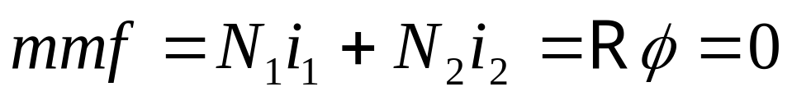
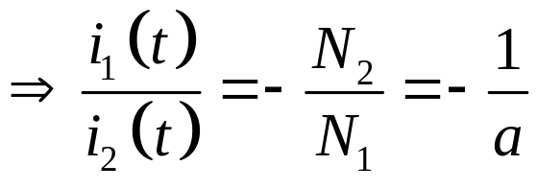
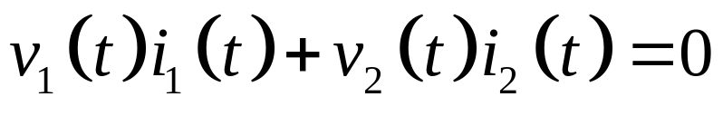


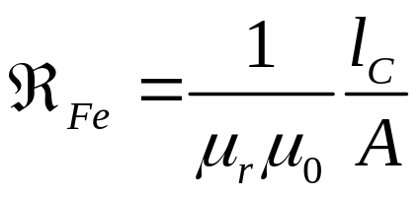
Ideal transformer (2)
Total mmf given
From (16), (17)
i₁
φ
i₂
+
+
v₁
N₁
N₂
v₂
–
–
(17)
(18)
i₁
Ideal
i₂
+
+
v₁
v₂
–
–
N₁:N₂
Trịnh Hoàng Hơn
ICA Lab

Slide 5
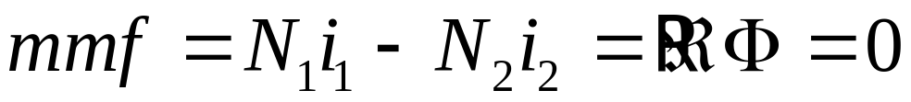
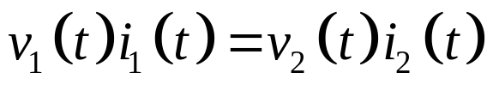
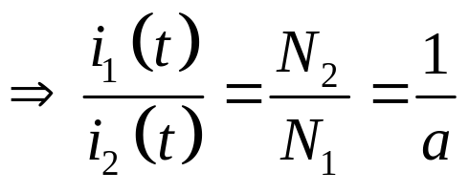
Ideal transformer (2)
i₁
Ideal
i₂
Re-chosen i₂
+
+
v₁
v₂
–
–
N₁:N₂
Total mmf given
From (16) & (19)
(20)
(19)
Trịnh Hoàng Hơn
ICA Lab

Slide 6
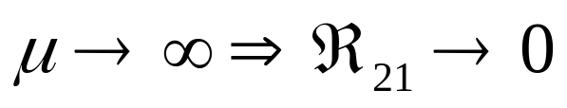
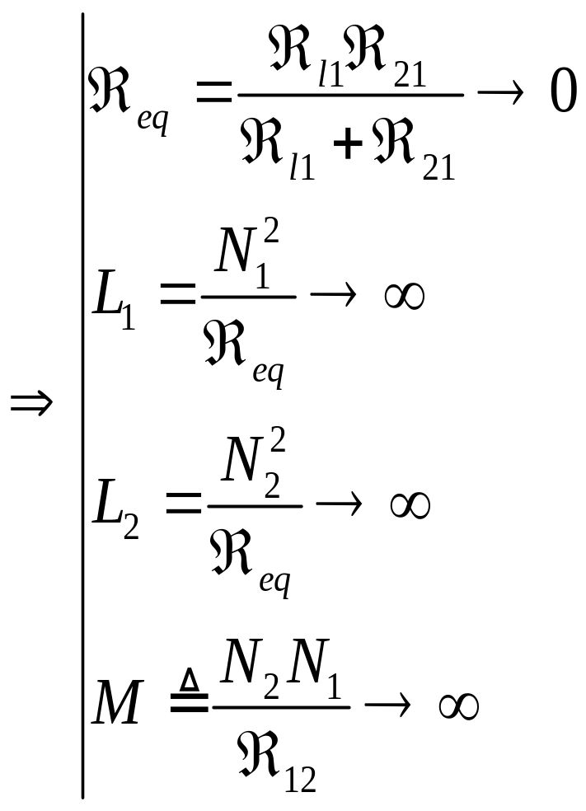
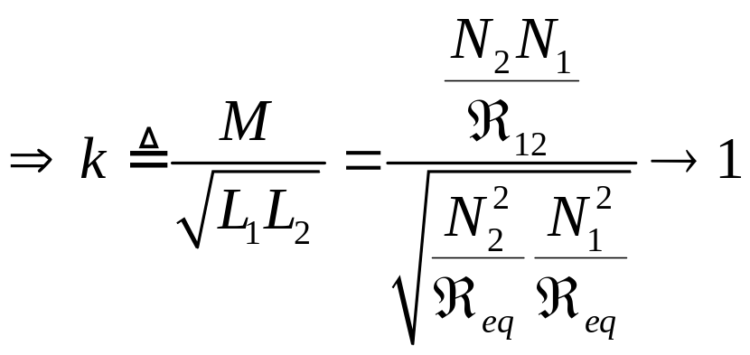
Ideal transformer (2)
Consequence
Tightly coupled coefficient

Slide 7
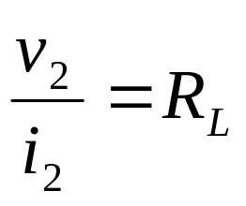
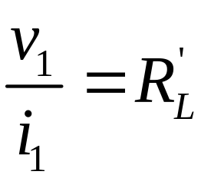
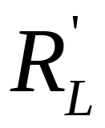
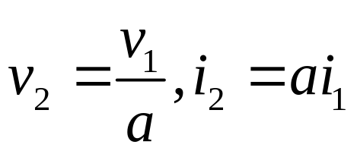
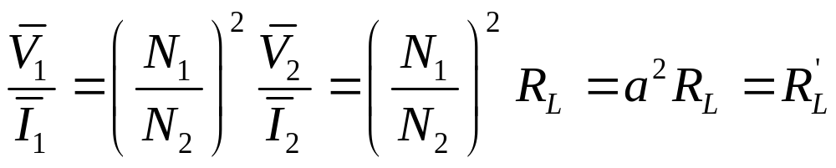
Impedance-changing property
Consider
  By Ohm’s law
  From (16) (19)
  →
i₁
Ideal
i₂
+
+
v₁
v₂
R_{L}
–
–
N₁:N₂
Trịnh Hoàng Hơn
ICA Lab

Slide 8
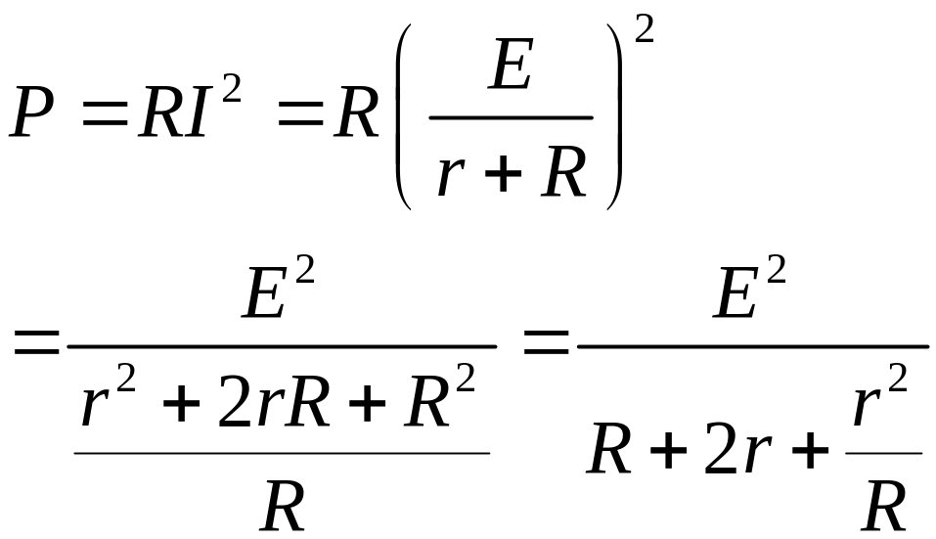
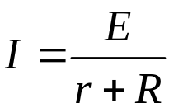
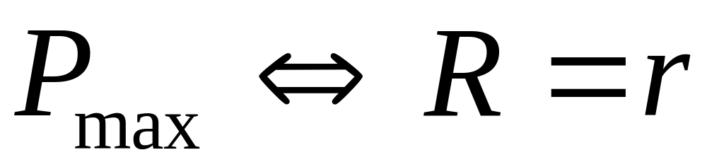
Impedance-changing property
I
r
E
R
Trịnh Hoàng Hơn
ICA Lab

Slide 9


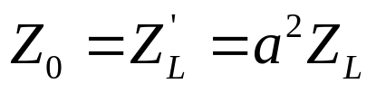
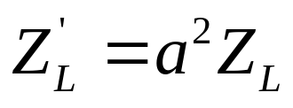
Impedance-changing property
Consequence
  Efficiency is maximum
    Turns ratio is designed
      such that
i₁
Ideal
i₂
+
+
v₁
v₂
R_{L}
–
–
(17)
N₁:N₂
Called matching impedance
Proof: Using inequality Caushy
Trịnh Hoàng Hơn
ICA Lab

Slide 10
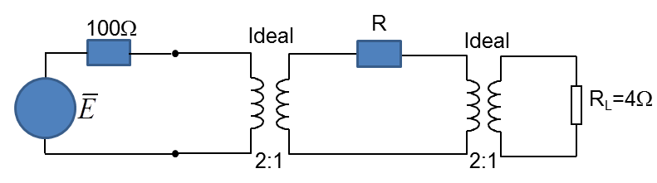
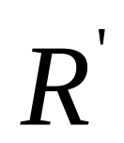
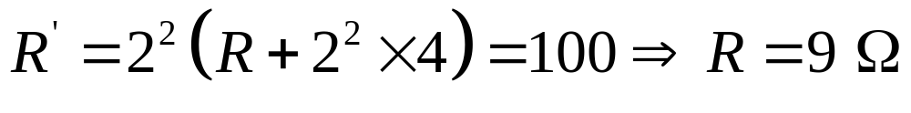
Impedance-changing property
Ex.3.7
Solution
R=?→ matching impedance
Transferred impedance
Trịnh Hoàng Hơn
ICA Lab

Slide 11
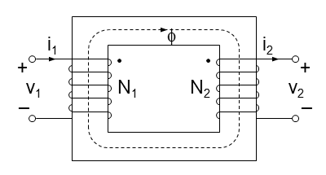
Power transformer
  “Primary” winding (N₁ turns) connected to power supply,
  “secondary” winding (N₂ turns) connected to load circuit
Trịnh Hoàng Hơn
ICA Lab

Slide 12
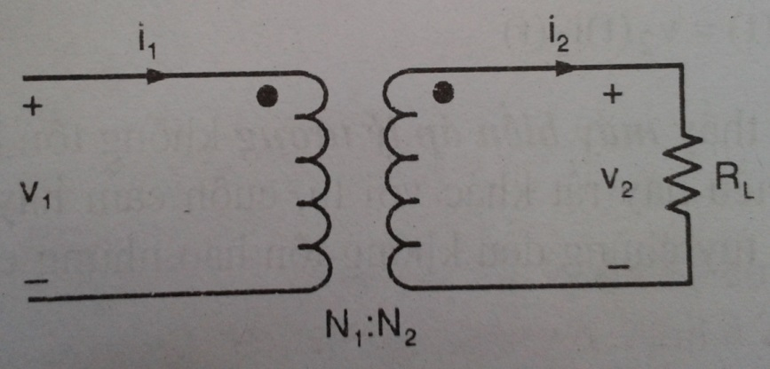
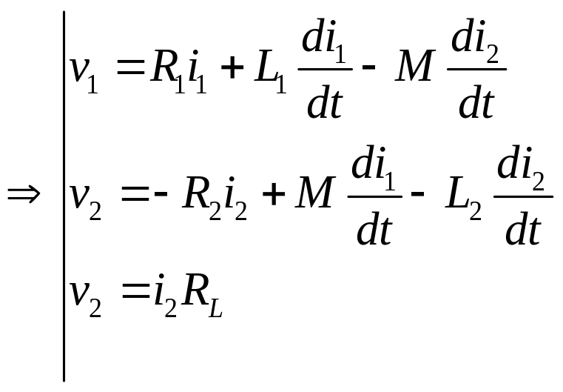
Power transformer
Consider,
Trịnh Hoàng Hơn
ICA Lab

Slide 13
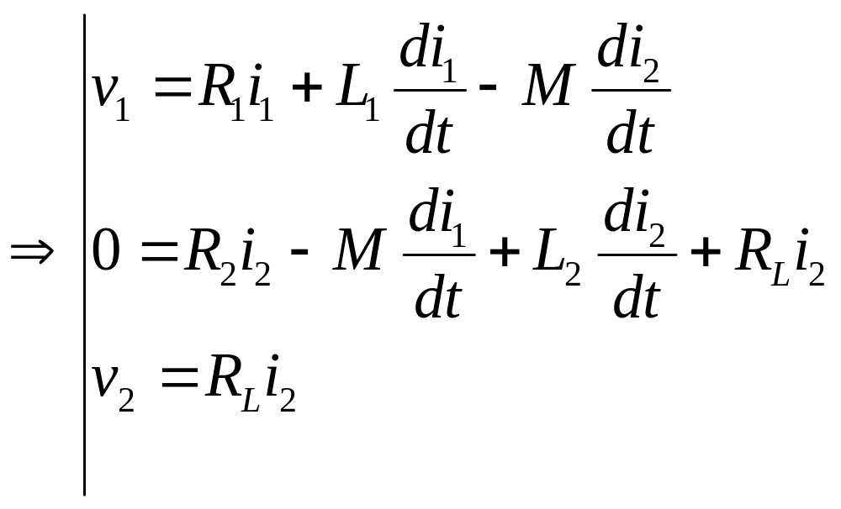
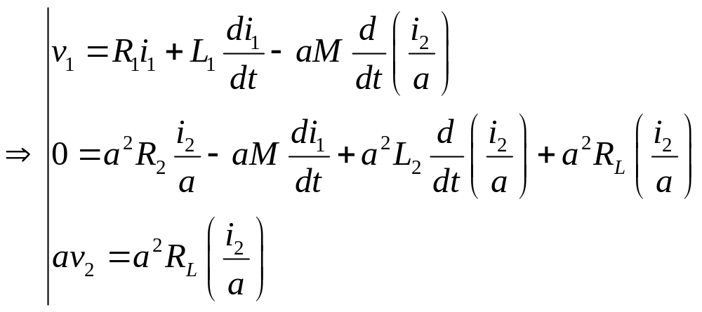
Power transformer
Trịnh Hoàng Hơn
ICA Lab

Slide 14
V=zi→kV=kzi=(kz)i=z(ki)=k²z(i/k)
S=vi*→S=kv(i*/k)
Trịnh Hoàng Hơn
ICA Lab

Slide 15
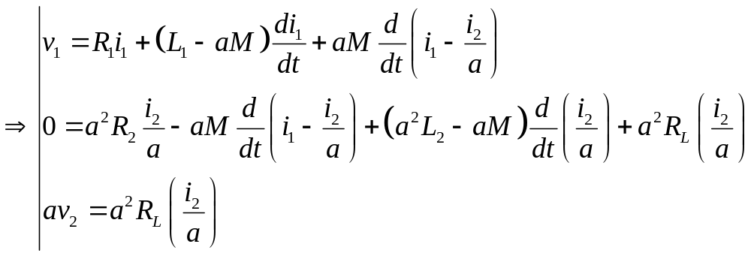
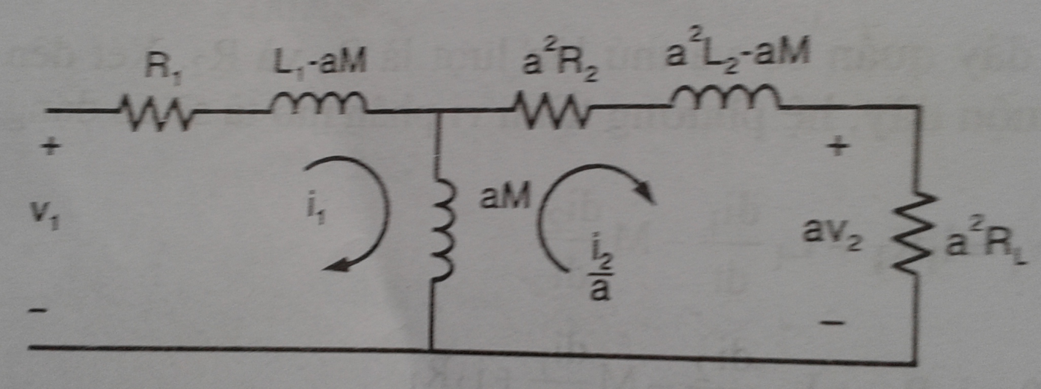
Power transformer
Using: Loop Analysis
of Electric Circuits
Trịnh Hoàng Hơn
ICA Lab

Slide 16
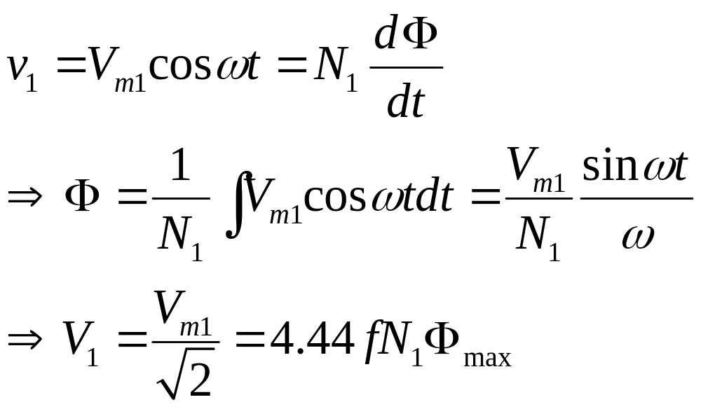
Power transformer
If primary voltage is
Trịnh Hoàng Hơn
ICA Lab

Slide 17
Power transformer
When the iron losses is mentioned
R₁
L₁-aM
a²R₂
a²L₂ – aM
+
+
R_{c1}
(aM)₁
a²Z_{L}
–
–
Trịnh Hoàng Hơn
ICA Lab

Slide 18
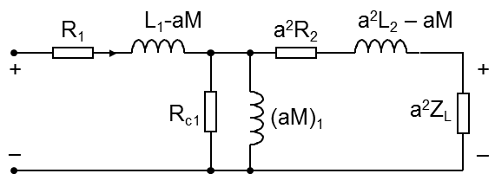
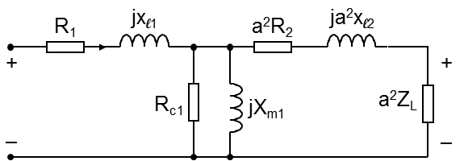
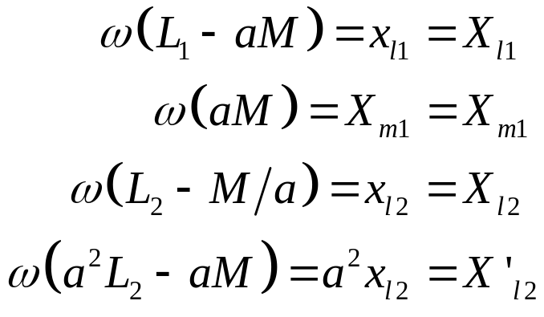
Power transformer
For steady-state operation,
  Impedances and phasors can be used
where
Leakage reactance of winding 1
Magnetizing reactance referred to winding 1
Leakage reactance of winding 2
Leakage reactance of winding 2 referred to side 1
Trịnh Hoàng Hơn
ICA Lab

Slide 19




Power transformer
All quantities can be referred to winding 1
R₁
jx_{l1}
a²R₂
ja²x_{l2}
+
+
R_{c1}
jX_{m1}
a²Z_{L}
–
–
Or they can be referred to winding 2
R₁/a²
jx_{l1}/a²
R₂
jx_{l2}
+
+
R_{c1}/a²
jX_{m1}/a²
Z_{L}
–
–
Trịnh Hoàng Hơn
ICA Lab

Slide 20




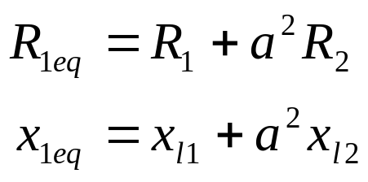
Power transformer
Approximate equivalent circuit
R₁
jx_{l1}
a²R₂
ja²x_{l2}
+
+
R_{c1}
jX_{m1}
a²Z_{L}
–
–
R_{1eq}
jx_{1eq}
+
+
R_{c1}
jX_{m1}
a²Z_{L}
–
–
Trịnh Hoàng Hơn
ICA Lab

Slide 21




Open- and short-circuit tests of transformers (1)
Parameters in equivalent circuit can be determined
    Simple tests: open-circuit test and short-circuit test.
The windings are called
    High-voltage (HV) and low-voltage (LV) windings.
A
W
V
R_{c}
X_{m}
LV
HV
Open-circuit test
Equivalent circuit
Trịnh Hoàng Hơn
ICA Lab

Slide 22
R_{1eq}
jx_{1eq}
+
+
R_{c1}
jX_{m1}
a²Z_{L}
–
–
A
W
V
R_{c}
X_{m}
LV
HV
Trịnh Hoàng Hơn
ICA Lab

Slide 23
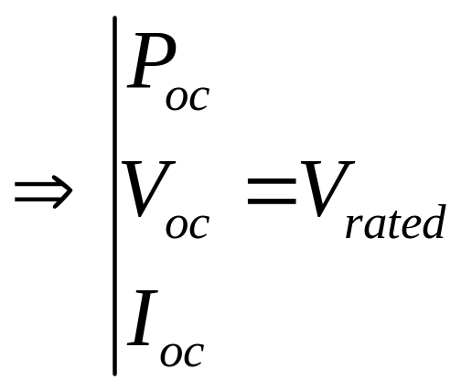
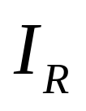
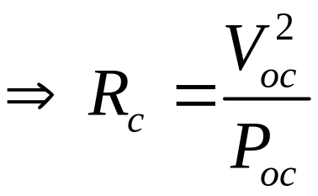
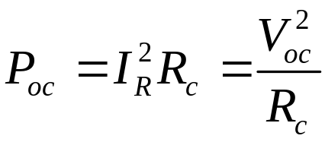
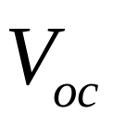
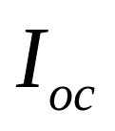
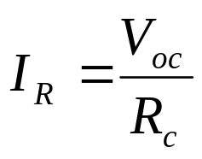
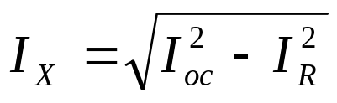
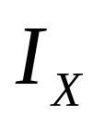

Open- and short-circuit tests of transformers (3)
A
W
V
R_{c}
X_{m}
LV
HV
Open-circuit test (LV side)
Equivalent circuit
R_{c} and X_{m} are the
values referred to
the LV side.
Trịnh Hoàng Hơn
ICA Lab

Slide 24









Open- and short-circuit tests of transformers (3)
A
W
R_{eq}
X_{eq}
short-circuit
test
V
Equivalent
circuit
HV
LV
R_{eq} and X_{eq} are referred to the HV side.
Trịnh Hoàng Hơn
ICA Lab

Slide 25
R_{1eq}
jx_{1eq}
+
+
R_{c1}
jX_{m1}
a²Z_{L}
–
–
A
W
R_{eq}
X_{eq}
short-circuit
test
V
Equivalent
circuit
HV
LV
Trịnh Hoàng Hơn
ICA Lab

Slide 26







Voltage regulation
Voltage regulation
Efficiency
Using approximate circuit
where,
Iron loss
where,
Copper loss
Using approximate circuit
Primary copper loss
Secondary copper loss
R_{1eq}
jx_{1eq}
Using exact circuit
+
+
Output power
a²Z_{L}
R_{c1}
jX_{m1}
Trịnh Hoàng Hơn
ICA Lab
–
–

Slide 27
Example 3.9
S_{rated}=7.5kVA, 440/220V
  OC test (LV side): 220V, 1A, 50W
  SC test (HV side): 15V, 17A, 60W
Equivalent circuit parameters referred to HV side?
Equivalent circuit parameters referred to LV side?
Trịnh Hoàng Hơn
ICA Lab

Slide 28
Example 2
A 15 kVA, 2200/220 V transformer has R_{c} = 195 Ω and X_{m} = 170 Ω referred to the LV side. R_{eq} and X_{eq} referred to the HV side are 6 Ω and 10 Ω, respectively. The transformer is supplying a load of 11.5 kVA on the LV side with 0.93 PF leading at 230 V.
a) Draw the approximate equivalent circuit with all parameters. (20 points)
b) Find voltage regulation and efficiency. (40 points
Trịnh Hoàng Hơn
ICA Lab

Slide 29
Homeworks
3.3
3.4
3.6
3.8
3.10; 3.11; 3.12; 3.14; 3.15; 3.16
3.18; 3.19; 3.21; 3.22; 3.23
Trịnh Hoàng Hơn
ICA Lab

Slide 30
Thanks!
Trịnh Hoàng Hơn
ICA Lab

Slide 31
2.5
2.11
2.19
2.20
3.2
3.6
3.14
3.15
3.19
3.23
Trịnh Hoàng Hơn
ICA Lab

Slide 32

Kiểm tra (20 phút)
Trịnh Hoàng Hơn
ICA Lab

